Slide 1
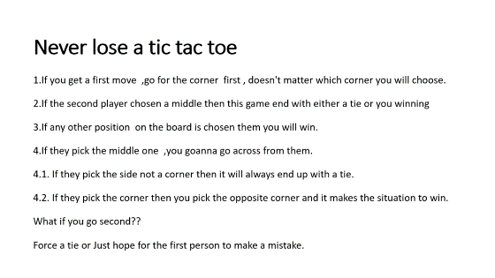
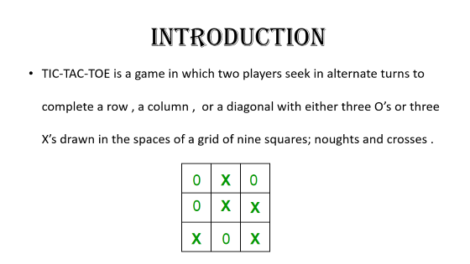
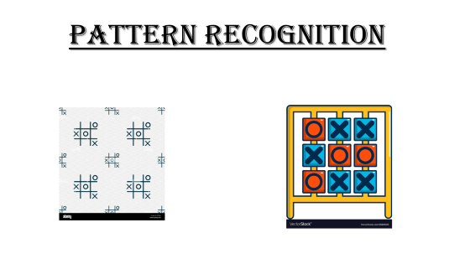
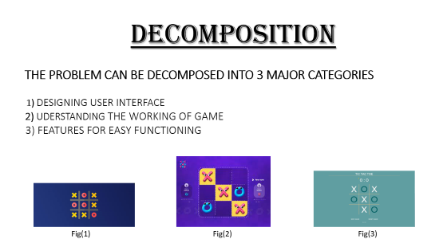

Slide 2
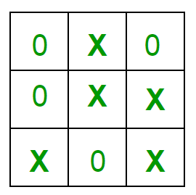
introduction
TIC-TAC-TOE is a game in which two players seek in alternate turns to complete a row , a column , or a diagonal with either three O’s or three X’s drawn in the spaces of a grid of nine squares; noughts and crosses .

Slide 3
PROBLEM DEFINITION
Tic-Tac-Toe is a very popular and is fairly simple by itself. It is actually a two player game .In this game ,there is a board with n*n squares. It is generally played in 3*3 squares .
The goal of Tic-Tac-Toe is to be one of the players to get three same symbols in a row - horizontally ,vertically or diagonally – on a 3*3 grid.
This game uses board to control players . In each turn player enter a number and choose a move.
Simply programming assumes that player one always moves first and uses X’s. player two moves at 2nd position and uses O’s.

Slide 4
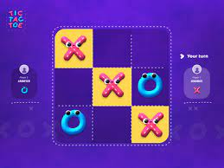
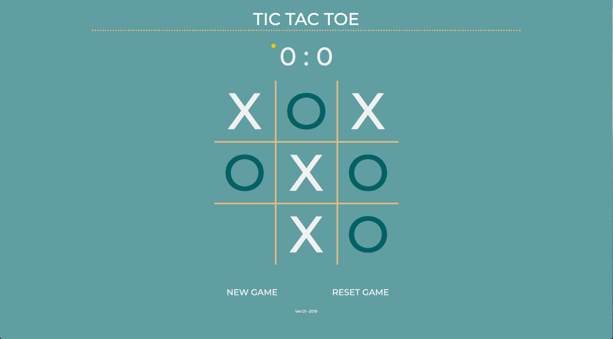

decomposition THE PROBLEM CAN BE DECOMPOSED INTO 3 MAJOR CATEGORIES 1) DESIGNING USER INTERFACE 2) UDERSTANDING THE WORKING OF GAME 3) FEATURES FOR EASY FUNCTIONING
Fig(1)
Fig(2)
Fig(3)

Slide 5
DESIGNING USER INTERFACE
A background providing a backdrop for the the entire game.
An element that will be our game board.
An element, or set of elements, that breaks the game board up into nine areas in an even grid.
Nine tiles that can be assigned either an "X" or and "O", but once assigned these values will persist and not be changeable by the players - either the current player or the opponent.
A display to represent the win and the number of wins for each player.
UNDERSTANDING THE WORKING OF GAME
Logic to change sides when a player takes their turn.
A program to understand what are the formations that represents win.

Slide 6
Logic to check for a "Win" condition, allowing for draws where no one wins.
Displaying who the winner is when the game is over.
FEATURES FOR EASY FUNCTIONING
A way to choose the starting player's side, "X" or "O".
An indicator of whose turn it is.
A restart button.
A key to start new game.
Level of difficulty.
A button to choose whether the opponent is a friend or computer.
A key to choose whether the player needs to be “X” or “O’’.
Very basic instructions.

Slide 7
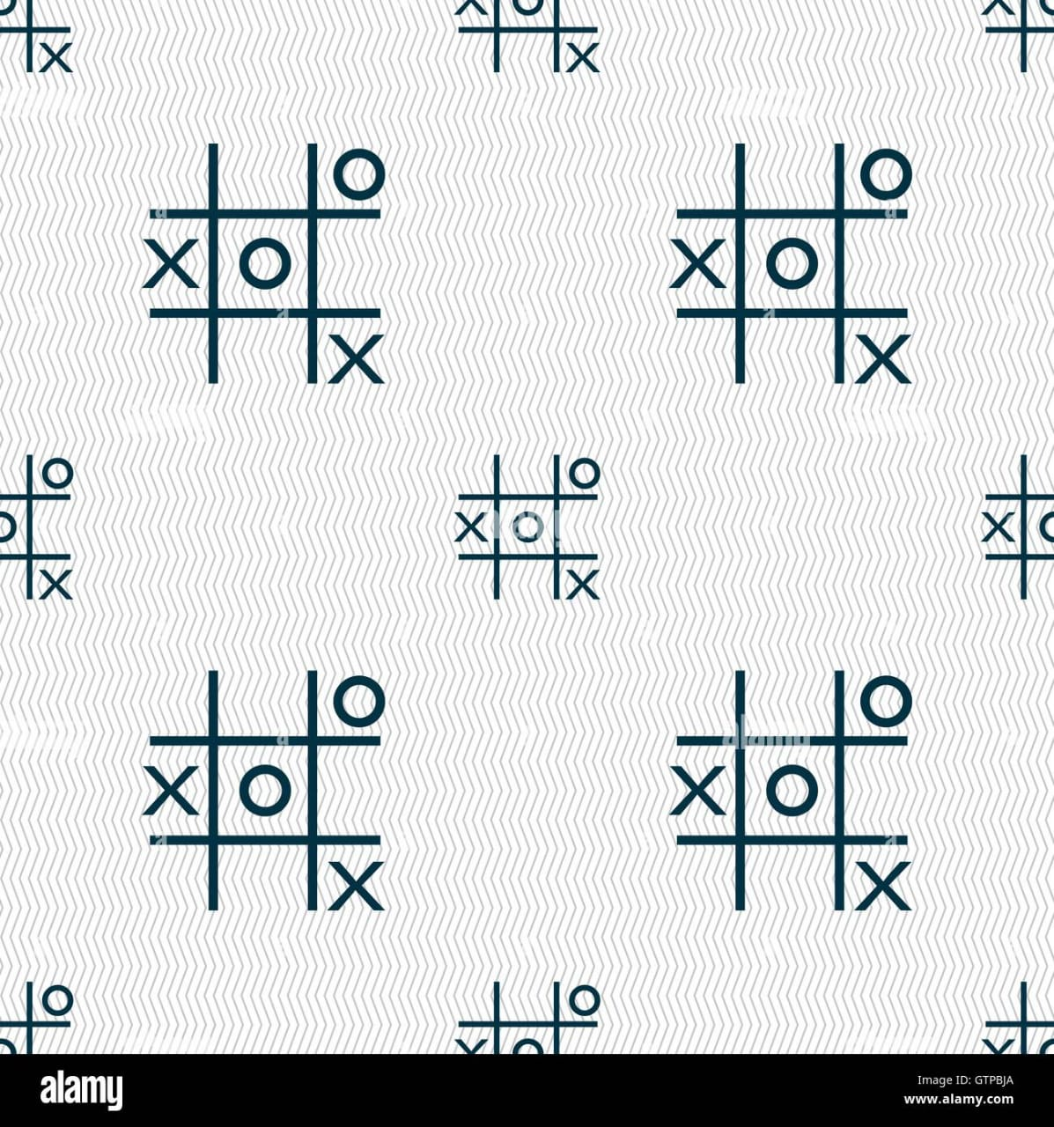
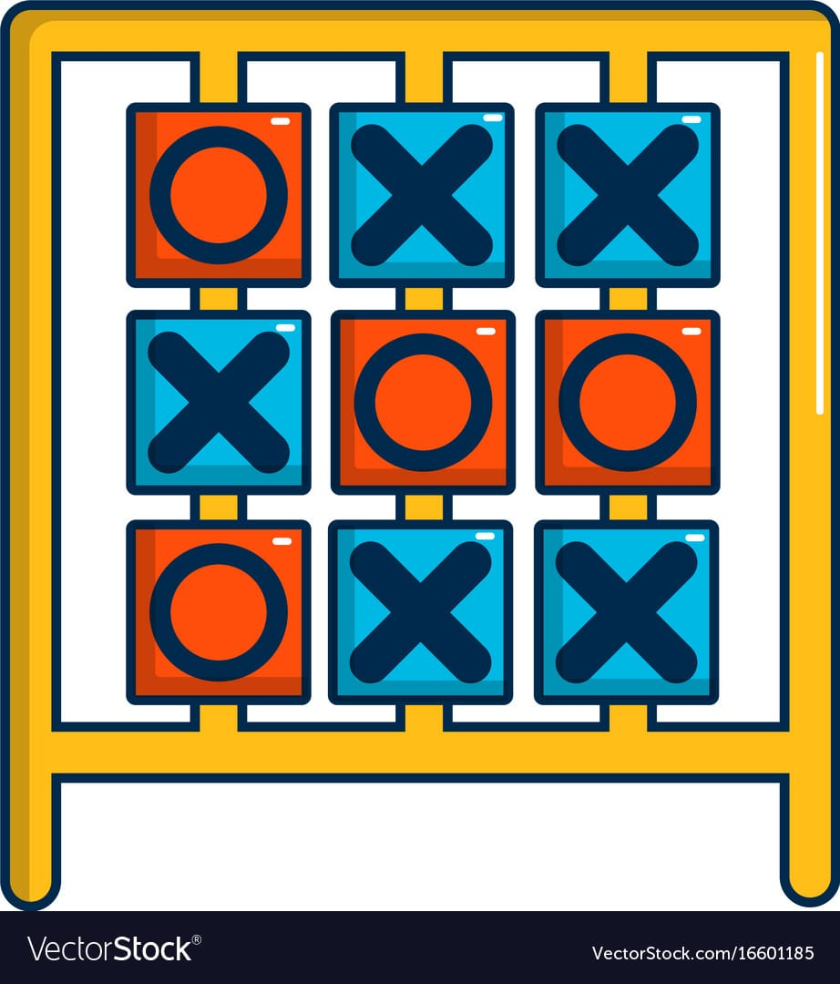
PATTERN RECOGNITION

Slide 8
PATTERN RECOGNITION IN TIC TAC TOE
Many games involve creating, identifying or predicting a pattern. This is a common element in many basic and electronic games. It is also an important element for many professional and academic skills. Pattern recognition is the ability to recognize order in a chaos or to see relationships in disjointed information. Patterns can be found in concepts, ideas, and series of words, symbols, numbers, and images. They can also be found in behavior, economies and historical events. In every discipline, patterns are crucial for predicting the future, estimating the right course of action and determining diagnostic steps

Slide 9
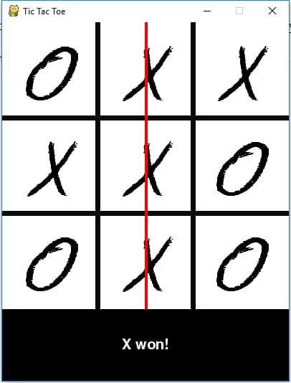
DETAILED ANALYSIS ON PATTERN RECOGNITION A simple example of a pattern recognition game is tic-tac-toe. In the game the player attempts to align 3 X’s or 3 O’s before an opponent can do the same. This process requires the player to both focuses on the pattern he or she is creating with their moves as well as the pattern of the opposing player. In tic-tac-toe, if both players are adept at pattern recognition, the game usually ends in a stalemate

Slide 10
ABSTRACTION
Abstraction is the process of filtering out - ignoring - the characteristics of problems that are not needed in order to concentrate on those that are needed. It is also the filtering out of specific details. From this, we can create an idea of what is to be solved
Abstraction allows us to create a general idea of what the problem is and how to solve it

Slide 11
WHAT THE PROBLEM IS ?
The game Tic Tac Toe is also known as Noughts and Crosses or Xs and Os ,the player needs to take turns marking the spaces in a 3x3 grid with their own marks,if 3 consecutive marks (Horizontal, Vertical,Diagonal) are formed then the player who owns these moves get won.
HOW TO SOLVE IT ?
The game is played on a grid that's 3 squares by 3 squares.
You are X, your friend (or the computer in this case) is O. Players take turns putting their marks in empty squares.
The first player to get 3 of her marks in a row (up, down, across, or diagonally) is the winner.
When all 9 squares are full, the game is over

Slide 12
Never lose a tic tac toe
1.If you get a first move ,go for the corner first , doesn't matter which corner you will choose.
2.If the second player chosen a middle then this game end with either a tie or you winning
3.If any other position on the board is chosen them you will win.
4.If they pick the middle one ,you goanna go across from them.
4.1. If they pick the side not a corner then it will always end up with a tie.
4.2. If they pick the corner then you pick the opposite corner and it makes the situation to win.
What if you go second??
Force a tie or Just hope for the first person to make a mistake.

Slide 13
How many scenarios are there in tic tac toe?
There are 255168 possible game of Tic-tac-toe excluding symmetry. The first player wins 131184 of these, the second player wins 77904 games and the remaining 46080 are drawn. As has been pointed out, with best play all games should result in a draw.

Slide 14
ALGORITHM:
1. Win: If you have two in a row, play the third to get three in a row.
2. Block: If the opponent has two in a row, play the third to block them.
3. Fork: Create an opportunity where you can win in two ways.
4. Block Opponent's Fork:
Option 1: Create two in a row to force the opponent into defending, as long as it doesn't result in them creating a fork or winning. For example, if "X" has a corner, "O" has the center, and "X" has the opposite corner as well, "O" must not play a corner in order to win. (Playing a corner in this scenario creates a fork for "X" to win.)
Option 2: If there is a configuration where the opponent can fork, block that fork.
5. Center: Play the center.
6. Opposite Corner: If the opponent is in the corner, play the opposite corner.
7. Empty Corner: Play an empty corner.
8. Empty Side: Play an empty side.

